Slide 1


TIVAS - Threat Identification and Visual Alert System
Transforming urban public safety through intelligent machine learning and predictive analytics
Team Members:
Shanmukha Devi - 2320030340
Nandini Nagar - 2320030397

Slide 2

The Urban Safety Challenge
Growing Urban Populations
As cities expand rapidly, ensuring public safety has become increasingly complex. Traditional crime analysis methods rely on static reports and historical records, making it difficult to anticipate future incidents and take preventive actions.
The result: Most crime management strategies remain reactive rather than proactive, responding to incidents after they occur rather than preventing them.

Slide 3




Intelligent Platform Overview
An intelligent web-based platform that leverages machine learning and data analytics to analyze crime patterns and predict crime-prone areas. The system processes historical crime data including crime type, timing, location, and frequency to reveal actionable insights.
Machine Learning
Data Analytics
Advanced algorithms that identify patterns and trends in crime data
Comprehensive analysis of historical crime records and frequencies
Predictive Power
Forecast future crime-prone areas with accuracy

Slide 4
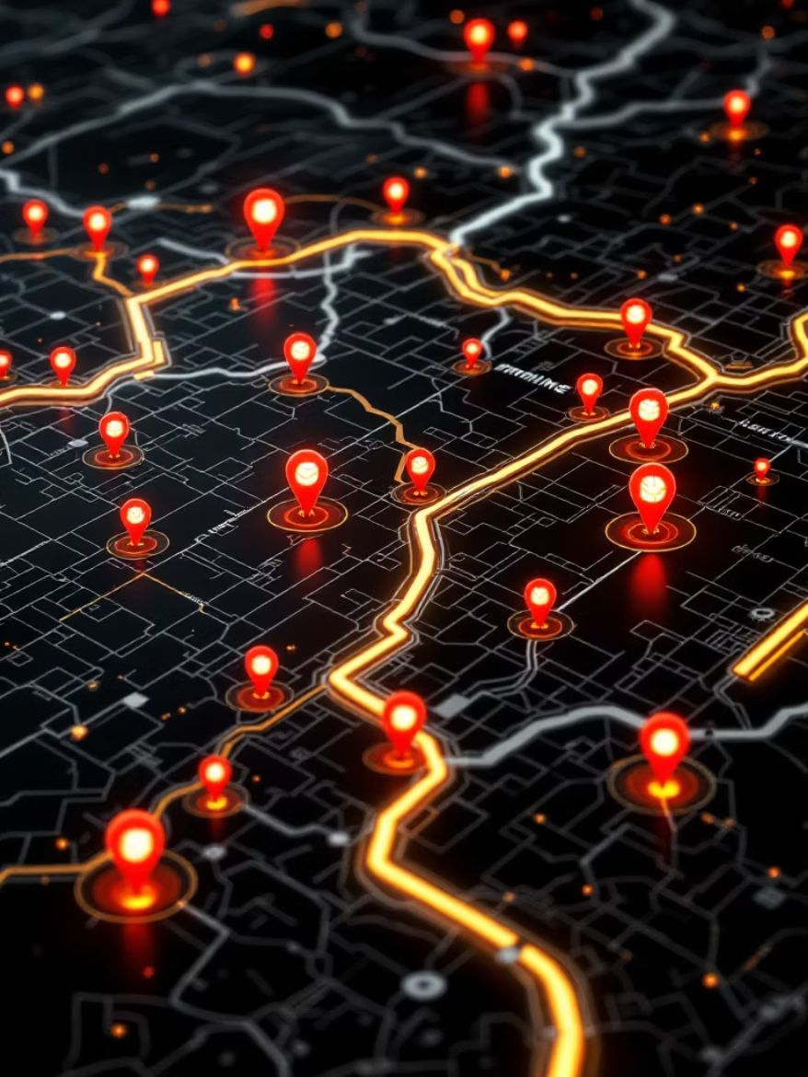
Crime Hotspot Visualization
The platform integrates interactive mapping technology using Google Maps or Mapbox to present crime predictions visually. Areas with higher crime probability are displayed as hotspots, enabling citizens and authorities to quickly identify risk zones.
This visual representation simplifies crime analysis and facilitates better decision-making for both individuals and law enforcement agencies.
01
02
Data Collection
Pattern Analysis
Gather historical crime records with time, location, and type
Machine learning identifies recurring patterns and trends
03
04
Hotspot Mapping
Decision Support
Visual display of high-risk areas on interactive maps
Authorities and citizens make informed safety choices

Slide 5




Safe Route Recommendation System
Route Analysis
Evaluates multiple possible paths between locations
Risk Assessment
Calculates crime risk scores for each segment
Optimal Path
Suggests safest routes for travel
The system provides safer navigation options, particularly valuable during nighttime or in unfamiliar locations. Users receive real-time alerts when approaching high-risk areas, enabling them to remain cautious and take preventive actions.

Slide 6

Admin Dashboard for Law Enforcement
Comprehensive Monitoring Tools
Police departments and security agencies gain powerful capabilities to monitor crime trends and patterns efficiently. The dashboard enables easy report preparation for strategic planning.
Real-time crime pattern visualization
Historical trend analysis
Automated report generation
Patrol route optimization
Resource allocation insights

Slide 7



Strategic Benefits
Proactive Prevention
Resource Optimization
Public Empowerment
Shift from reactive response to preventive measures through predictive analytics and early warning systems
Deploy law enforcement resources more effectively by focusing on predicted high-risk areas and times
Enable citizens to make informed decisions about travel routes and neighborhood safety through accessible data

Slide 8

Technology Stack
Machine Learning Models
Mapping Integration
Google Maps API
Mapbox visualization
Interactive layer controls
Pattern recognition algorithms
Predictive analytics engines
Trend detection systems
Data Infrastructure
Historical crime databases
Real-time data feeds
Analytics processing pipeline

Slide 9
Implementation Roadmap
Phase 1: Data Integration
Phase 3: Pilot Program
Connect historical crime databases and establish data pipelines
Deploy in select neighborhoods for validation
1
2
3
4
Phase 2: Model Training
Phase 4: City-Wide Rollout
Train machine learning algorithms on historical patterns
Expand to entire metropolitan area with full features
Expected Timeline
Key Milestones
6-9 months from initial deployment to full operational capability
Quarterly reviews with law enforcement stakeholders

Slide 10




Making Safer Cities Together
A prime example of modern technology creating safer urban environments
This AI-powered system demonstrates how intelligent technology can transform public safety from reactive response to proactive prevention. By combining machine learning, data analytics, and interactive visualization, cities can protect their citizens more effectively while optimizing law enforcement resources.
City Partnerships
Law Enforcement
Collaborate with municipal governments
Integrate with police departments
Public Engagement
Empower citizens with safety tools

Slide 11
THANK YOU

